Slide 1
QA Engagement during User Acceptance Testing
Elizabeth Wisdom
2/18/2015

Slide 2
Agenda
What is User Acceptance Testing?
What is the Objective of User Acceptance Testing?
QA vs. UAT: Managing Expectations
Planning for UAT
Entry/Exit/Success Criteria for UAT
UAT Execution
UAT Metrics and Reporting
What Happens After Go-Live?

Slide 3
Objective for Today
How can QA effectively engage with the UAT team and project stakeholders before and during the UAT test event to maximize the effectiveness and efficiencies of both teams
Notes:
Quality Assurance Testing and User Acceptance Testing have obvious similarities, yet each have unique objectives. Ideally, QA and UAT are performed by different teams and at different intervals in the project timeline. QA are the SMEs in defect detection, removal, and testing process governance, while oftentimes the UAT team are the functional SMEs in their respective business area and “not so much” in the testing space – and could benefit from QA’s guidance to make it a success as well as a well-defined repeatable process. This presentation will show how QA can effectively engage with the UAT team and project stakeholders before and during the UAT test event to maximize the effectiveness and efficiencies of both teams.

Slide 4
What is User Acceptance Testing?
User Acceptance Testing (UAT) is:
“Formal testing conducted to determine whether or not a system satisfies its acceptance criteria based on the business requirements, which enables the functional users to determine whether or not to accept the system.”

Slide 5
Expectations for UAT
Expect defects to be found! This adds to the overall quality of the solution.
A thoughtfully planned and well-executed UAT will enable users to verify that the system under development meets business requirements.
Associates/users will become more familiar with the new functionality that is being introduced – developing the expertise required for roll-out and training.

Slide 6
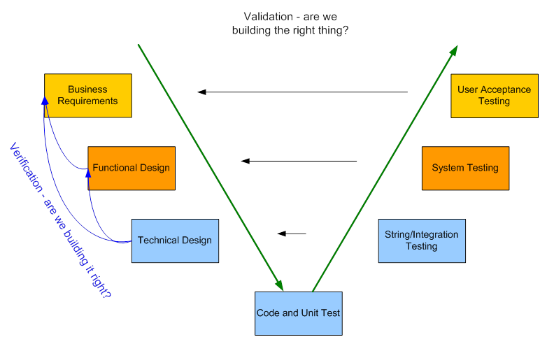
The V-Model
Notes:
Throughout a project’s lifecycle, there are various test events and each has its unique objective. This is depicted in the following diagram (commonly referred to as the V-model). The intent here is to show that each test event is focusing on a different set of specifications. For example, QA performs System Testing, which focus is on the functional specifications whereas UAT is focused on business requirements. By having each team focused primarily on their respective specifications, all of the specifications will be covered with minimal redundancy.

Slide 7
QA vs. UAT: Managing Expectations
Clarify, document, review, and approve expectations for QA and UAT during the early planning stages of the project:
Test Strategy: describes process, standards, and tools used
Test Plan: identifies scope, assumptions, risks, dependencies, entry/exit/success criteria, data and environment requirements
RACI chart for all QA and UAT test activities
High level review at project core team meeting and with resource managers – get on the agenda!
Notes:
Oftentimes, the lines get blurred between System Testing and User Acceptance Testing from the perspective of the project stakeholders and even the project manager (“It’s all testing, right?”). The QA team makes assumptions about UAT, UAT makes assumptions about QA, and the project manager often sees QA owning it all.
Properly preparing for the transition from System Testing (performed by QA) to User Acceptance testing (performed by functional users) is all about managing expectations. Those expectations need to be clarified, documented, and reviewed/approved by all project stakeholders during the early planning stages of the project. I found the most effective way to do this is to develop a RACI chart of all QA and UAT test activities and review these with the project stakeholders (primarily, the leads for QA, UAT, and development) as well as the project manager. This chart -- listing who is Responsible, Accountable, Consulted, and Informed for each task -- should cover everything from test case planning, data required, test environment management, defect management as well as test event logistics (who manages rooms, dates, times, schedule, etc). A sample for UAT activities is included here.

Slide 8
Sample RACI - Definitions
Responsible: Performs the activity. The Executer, the Doer.
Accountable: Ensures that the activity is done on time or communicates delays. The Overseer. Has yes/no decision rights. Has veto power.
Consulted: From whom input is required. It is not optional. The input must be considered. It may be overridden by the Accountable, but must be for a valid reason.
Informed: To whom information must be reported. It is not optional.
Team Definitions
FL: Business Functional Lead
FT: Business Functional Team
PT: Project Team
IT: IT Team (Apps, Ops) participating in the project QA: Quality Assurance Lead/Manager PM: Project Manager

Slide 9
Sample RACI Chart – UAT Prep
Activity | R | A | C | I
UAT Preparation (Design and Build) | UAT Functional Team (FT), QA | QA | PM
Resource Plan for test environment build/verification used for UAT | PM | PM | IT, QA
UAT Test Environment build | IT (Apps/DBAs) | PM | IT, QA
UAT Test Environment verification and environment issue resolution | QA | QA | IT
Test Strategy & UAT Test Plan Scope and Defect Naming and identification | QA | QA | PM, Project Team (PT)
Entrance, Exit & Success Criteria | FT | PM | QA
Scenarios | FT | FL | PM, QA
UAT Training (Overview, Test Case Development & Execution, Defects) | QA | QA | PM | FT
Test Case Creation | FT | FT | QA
Test Set Creation | FT | FT | QA
Schedule of each test case (who does what when) | FT, UAT Lead | FT, UAT Lead | QA | PM
Reporting (metrics w/ analysis) - Progress of Cases, Sets, Assignments, Schedule | QA | QA | PM | FT
Test data management | FT | FL | QA, IT
Communication | UAT Lead | UAT Lead | QA | PT
Defect Prioritization | FT | PM | IT Owner | QA
Defect Resolution | IT,PT | IT Owner, PM |  | QA
Job Scheduling - Exceptions | IT Lead | IT LEAD | PM | FT

Slide 10
Sample RACI Chart – UAT Execution
Activity | R | A | C | I
UAT Execution | FT,PM | FT,PM | QA, PT | IT
Daily stand-up | UAT Lead | UAT Lead | QA Manager | PT
Logistics (rooms, food, prizes) | PM, UAT Lead | PM, UAT Lead | FT | QA
Scheduling Support Resources (IT, QA, PM) | PM | PM |  | FT
Management of overall schedule | PM | PM | QA, FT | PT
Status/Metric Reporting (QC and defect tracking system) | QA | QA | PM | PT
Communication | UAT Lead | UAT Lead | QA | PT

Slide 11
Sample RACI Chart – UAT Defect Management and Environment Change Control
Activity | R | A | C | I
Defect Management – Process | QA | QA | IT Apps | PT
Defect Management – Execution | QA | QA | IT Apps | PM
Defect Resolution | IT,PT | IT Owner, PM | QA
Environment change control (ECC) | Operations | QA | Apps, PM | PT
Environment exceptions | QA,Operations | QA | IT,PT
Coordination | QA | QA | PM, IT

Slide 12
Planning for UAT: Define the Team
Define who the UAT Team is and what role(s) they will fill:
Functional SME: the functional resource with expertise in the business process and understanding of the functional design
Ensures appropriate test case scenarios are planned and ready for the test event. May delegate test case development to other SMEs.
Answer questions and troubleshoots the use of the system and relevant data issues.
Logs defects for issues that do not conform to specification or expectations.
Approve change requests for implementation if change meets requirements, or if acceptable workarounds are in place for implementation.
Assigns, educates, and engages test executors for test case execution.
Communicate defects that impact training materials to the training lead/SMEs & keep them apprised of resolution/workarounds.
Notes:
Functional testers are business SMEs, who know their business processes inside and out. Planning for UAT may be outside their core skills, and that’s where help from QA is needed most. Define a repeatable process for UAT and a UAT Test Plan Template that can be reused over and over again and ensure it covers the 4 W’s (Who, What, Where, When) and How:

Slide 13
Planning for UAT: Define the Team
Test Executors: the functional subject matter experts in a particular business domain (e.g. accounts payable, invoicing, order fulfillment, supply chain, etc.)
Set up required data in test environment as per data seeding approach, including job scheduling.
Execute assigned test cases in the test environment and log results.
Log defects or enhancements.
Communicate with other test executors if prerequisites or handoffs are required to continue with testing.
Communicate issues/challenges with functional tester immediately.

Slide 14
Planning for UAT: Define the Team
UAT Facilitator: answers questions and troubleshoots the use of defect/test management tools. The UAT Facilitator is an IT Project Manager or QA resource with expertise in testing policies, processes, and tools.
Communicates and monitors target dates for test case preparation, including facilitation of weekly meetings if needed.
Ensures test event has reserved conference room space, connectivity, monitors, etc.
Monitors overall schedule and raises issues or risks that will hinder ability to meet entrance or exit criteria.
Facilitates daily stand-up meeting.
Implements process for prioritizing defects.

Slide 15
Planning for UAT: Define What to Test
UAT Test Plan:
Test scope
Data requirements
Environment requirements, including availability and access
Assumptions, Dependencies, Risks
When test cases are available:
Identify who will be testing which test cases on which days – communicate the schedule prior to UAT
Identify who will be creating the test data by when

Slide 16
Planning for UAT: Define When and Where to Test
Centrally co-locate the test executors (same room is best!).
Reserve room(s) and communicate the plan.
Have the development lead and the QA lead also present during UAT for support and quick turnaround of blocking issues.
Ensure test environment is available and test executors have proper access.

Slide 17
Planning for UAT: Define How to Test
Define and communicate how UAT will look in terms of:
Process
Tools
Test case management
Defect management
Reporting
Provide logins and training for any test case management tool or defect tracking system before UAT.
Otherwise, have a standard test execution template that is accessible for everyone and that the process for filling it out is understood.

Slide 18
Planning for UAT: Providing Training
Provide separate and just-in-time training throughout the UAT planning phase:
UAT Overview – the Why, What, Who, When, Where, and How of UAT
UAT Test Planning Part 1 (Scenarios) – what is a scenario, how to document high level scenarios (how to put them in a test management repository, scenario standards, etc.), approving scenarios
UAT Test Planning Part 2 (Test Cases) – breaking down scenarios into positive/negative test cases with detailed steps, prerequisites, test objectives, test case standards, and traceability back to business requirements.
UAT Test Execution – how to execute test cases and document test results, reporting and logging defects, defect retest process, defect prioritization, UAT metrics, test case scheduling and assignment, logistics
Notes:
It’s best to schedule these trainings the week prior to the start date of the milestone for which that training is targeted for – for example, if high level scenarios are due to start in week 8 of a project, provide the training near the end of week 7 so it’s fresh in their minds.

Slide 19
UAT Entrance Criteria
Document Entrance/Exit/Success in UAT Test Plan and reiterate at Core Team Meeting
Obtain approval prior to the start of the UAT test event
Example:
Critical and High functionality is complete and deployed to the test environment
Configuration guide is complete and all configurations are completed in the test environment
System Test (QAT) is 95% complete, with 95% pass rate and no blocking/critical open issues.
UAT test cases are complete and approved, and test case schedule is known to all participants.
Notes:
It’s important to determine and agree upon Entry/Exit Criteria for UAT and what constitutes Success. This should be documented in the UAT Test Plan (and reiterated at the project core team meeting), reviewed and approved so that at the end of the UAT test event, there will not be any debate over when UAT should end and if it was deemed successful.

Slide 20
UAT Exit Criteria
Example:
96% of all planned tests are executed and reflected in test event metrics.
All failed test cases have a defect logged and all business functionality defects are associated with a failed test case.
Business review and agreement of all open defects by severity and priority by <date>.
No unresolved Critical defects and all unresolved H/M/L defects have a resolution plan.

Slide 21
UAT Success Criteria
Example:
98% of executed test cases pass

Slide 22
UAT Execution
Communicate daily plan/schedule
Prepare and distribute Daily UAT Metric Report (use a template)
Conduct daily standup with all participants:
Communicate and prioritize issues found during the day
Ensure defect fixes are retested and when next set of fixes will be available
Monitor planned vs. actual test execution to ensure testing stays on track (if not, provide mitigation plan)
Notes:
Ideally, UAT testers are in a designated room with the QA lead and development lead. QA is there to help with environment issues as well as support for the application under test and the test and defect management tools. A daily standup meeting with all participants is recommended to communicate and prioritize issues found. QA should be ensuring defect fixes are retested and looking at planned vs. actual execution metrics so that the testing stays on track. Lastly, QA should prepare the daily metric report which should be discussed during the UAT daily standup meetings. Having a standard template for reporting UAT metrics is recommended and sets the expectation of what information is going to be reported.

Slide 23
UAT Metrics and Reporting
At a minimum, UAT Metrics Report should include:
Defects: #open/closed by severity and status (if many, then in priority order)
Test execution: plan vs. actual and pass rate
Break down by business area or team, if applicable
Overall
Notes:
As with QA System Test, metrics on defect detection and test execution should be done throughout the UAT test event. It should be concise and at a level so that at the daily standup, it’s clear where things are at in terms of defects found, blocking issues, and how test execution is going per the plan. If multiple business areas are participating in UAT, it’s helpful to not only show overall progress, but the breakdown per team.

Slide 24
UAT Metrics and Reporting
Example of Overall Test Execution Progress:
UAT Test Execution Summary (Project ABC)
Date | Passed | No Run | Not Completed | Failed | Blocked | N/A | Total | Success Rate | Test Case Coverage
10/7/2014 | 546 | 1517 | 3 | 18 | 0 | 0 | 2084 | 97% | 27%
10/8/2014 | 884 | 1151 | 3 | 45 | 0 | 1 | 2084 | 95% | 45%
10/9/2014 | 1107 | 923 | 1 | 48 | 0 | 5 | 2084 | 96% | 56%

Slide 25
UAT Metrics and Reporting
Example of Detailed Test Execution Breakdown:
UAT Test Execution Breakdown
Function | Passed | No Run | Not Completed | Failed | Blocked | N/A | Total | Success Rate | Test Case Coverage
Feature 1 | 0 | 1 | 0 | 0 | 0 | 0 | 1 | 0% | 0%
Feature 2 | 18 | 35 | 1 | 3 | 0 | 0 | 57 | 86% | 37%
Feature 3 | 7 | 3 | 0 | 0 | 0 | 0 | 10 | 100% | 70%
Regression | 120 | 7 | 0 | 0 | 0 | 0 | 127 | 100% | 94%

Slide 26
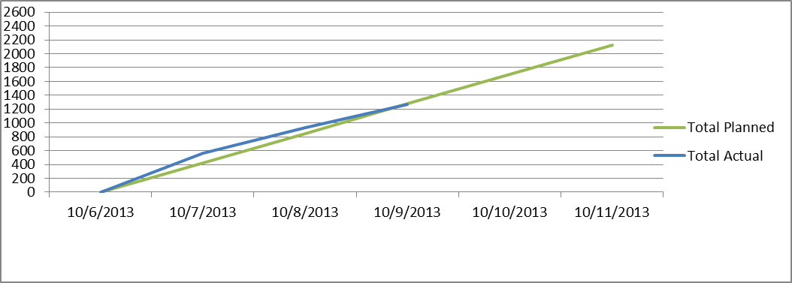
UAT Metrics and Reporting
Example of Planned vs. Actual Test Execution Trend:

Slide 27
UAT Metrics and Reporting
Example of Defects Detected by Severity and Status:

Slide 28
Post Go-Live: Lessons Learned and Continuous Improvement
Issues will occur!
Perform root cause analysis on post go-live issues to determine what process improvements need to be made and whether test cases or data need to be added or updated to the test suites.
Conduct Lessons Learned session with all UAT participants and project stakeholders on what went well and what could have been done better.

Slide 29
Q&A

